Slide 1
Week 2: Operations

Slide 2
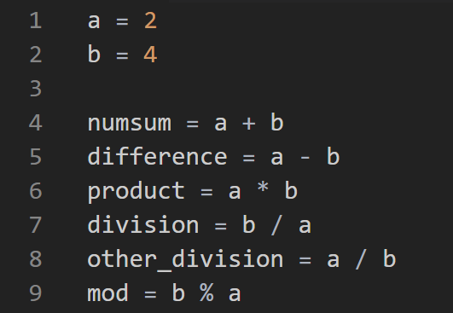
Operations

Slide 3
Navigating Using the Terminal
ls = what is in the directory now
cd = go back to the home directory
cd + directory name = enter into this directory

Slide 4
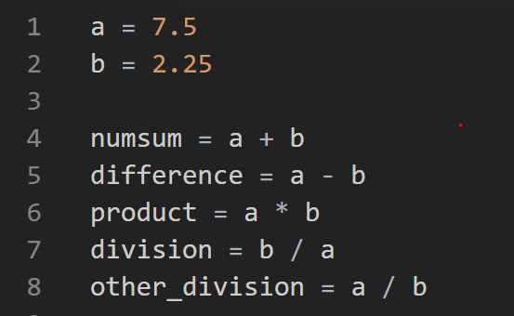
Operations- Numbers

Slide 5
Operations- Strings
+ is concatenation
This is just putting the two string together
* is also concatenation
Just like algebra, * is an extension of +
- and / will give an error

Slide 6
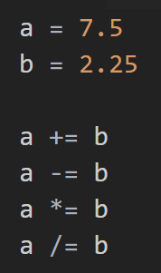
Combining Operator with Assignment

Slide 7
Exercise
Print the following:
“Hello, world!”
The sum of 82367 and 91567.423456
1024 times 476582

Slide 8
Booleans and operations

Slide 9
Comparison Operations
== | Equals
!= | Not equal to
> | Greater than
< | Less than
>= | Greater than or equal to
<= | Less than or equal to

Slide 10
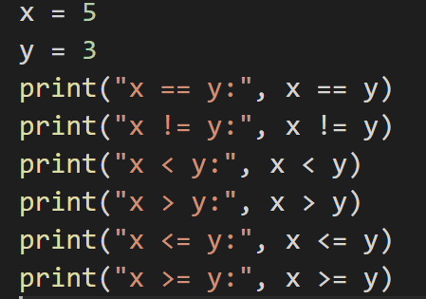

Slide 11
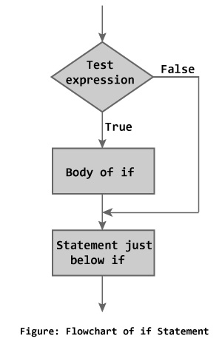
If Else

Slide 12
If/Else Notes
Any lines that are indented after the if: are considered “part of the if block”
elif MUST follow an if
In one block you can have only one if and one else, but can have as many elifs as you want

Slide 13
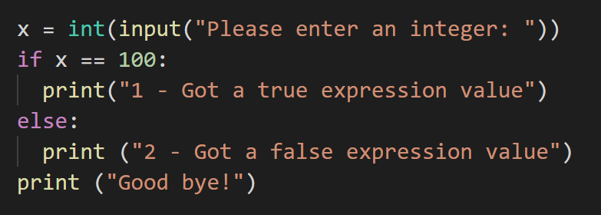
If Else

Slide 14
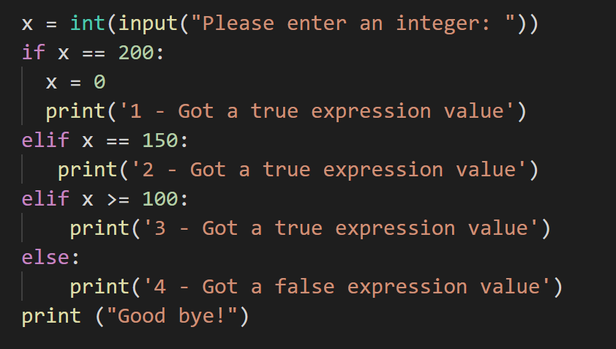
If Elif
Notes:
What happens here if I input 200?
150? 125?
100?
50?

